Slide 1
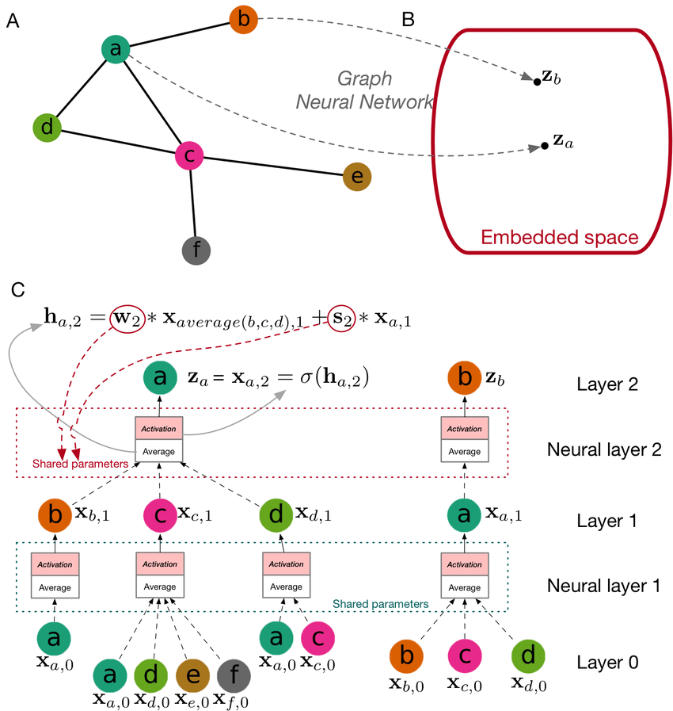

Graph Neural Networks I
张江
北京师范大学系统科学学院教授
集智俱乐部、集智学园创始人
集智研究中心理事长
更多“人工智能 & 复杂系统”的知识，请关注官网：campus.swarma.org
Notes:
封面

Slide 2
Outline
Background
Network Embedding
Graph Neural Networks
Graph Convolution
Graph Attention Network
Other extension
History and Spectral Domain
更多“人工智能 & 复杂系统”的知识，请关注官网：campus.swarma.org

Slide 3
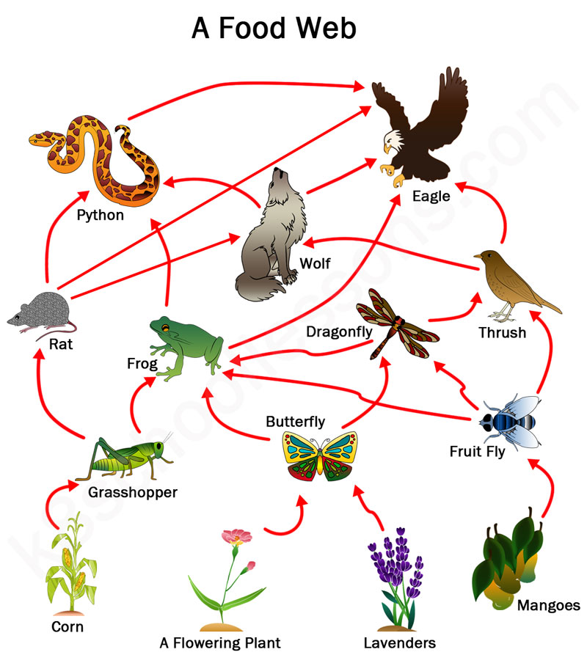
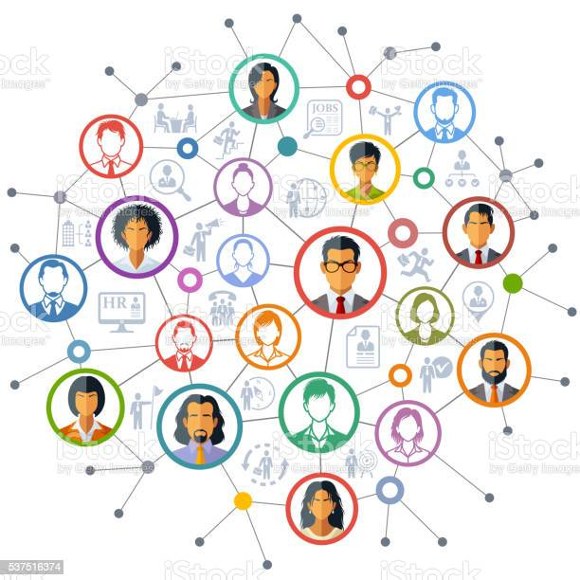
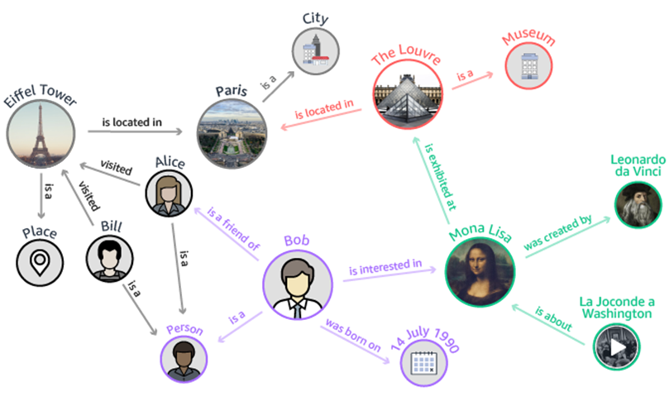
Networks Are Everywhere
更多“人工智能 & 复杂系统”的知识，请关注官网：campus.swarma.org

Slide 4
Images v.s. Graphs
Image = 2D Grid
Social Network
Regulatory Network
Functional Network
Michael Bronstein et al., Geometric Deep Learning, CVPR Tutorial 21 July 2017, Honolulu
更多“人工智能 & 复杂系统”的知识，请关注官网：campus.swarma.org

Slide 5
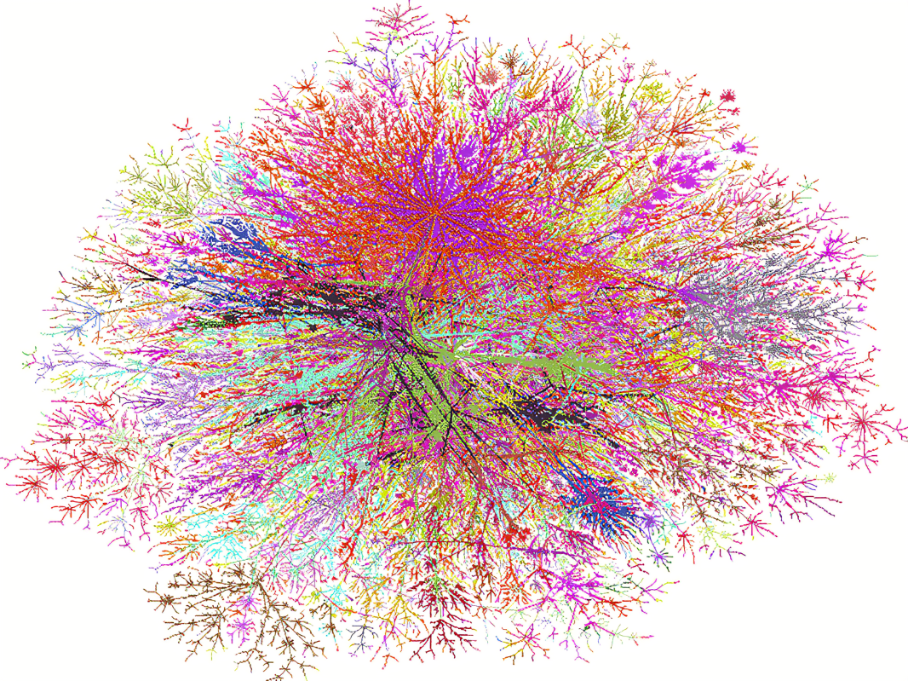
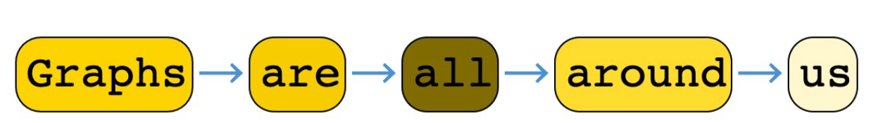
Sequences v.s. Graphs
更多“人工智能 & 复杂系统”的知识，请关注官网：campus.swarma.org

Slide 6
Outline
Background
Network Embedding
Graph Neural Networks
Graph Convolution
Graph Attention Network
Others
History and Spectral Domain
更多“人工智能 & 复杂系统”的知识，请关注官网：campus.swarma.org

Slide 7
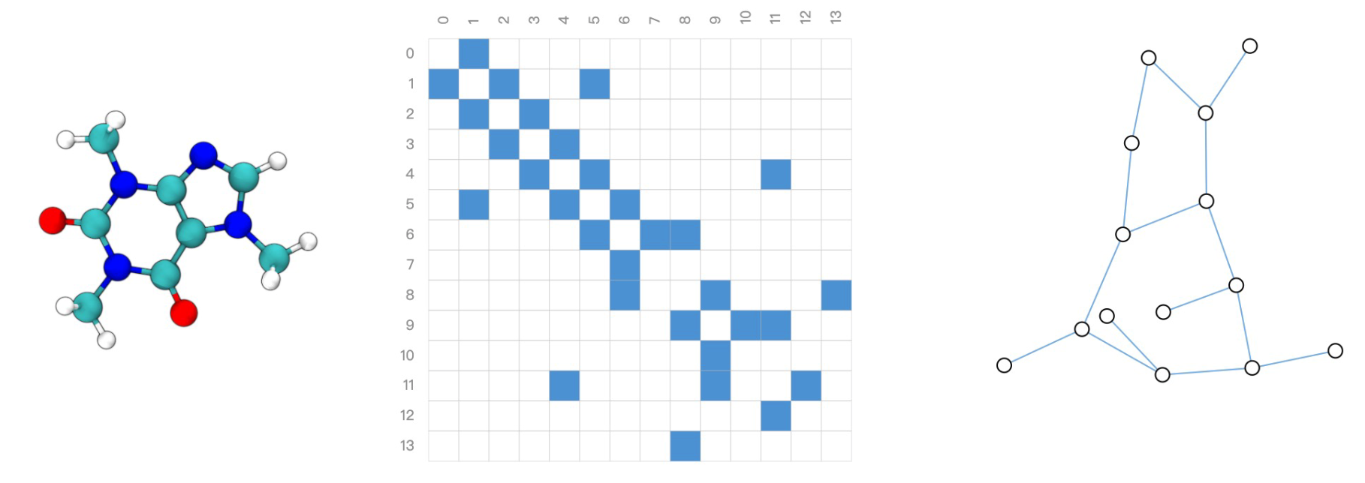
How to represent a graph?
分子结构式
图
邻接矩阵
更多“人工智能 & 复杂系统”的知识，请关注官网：campus.swarma.org

Slide 8
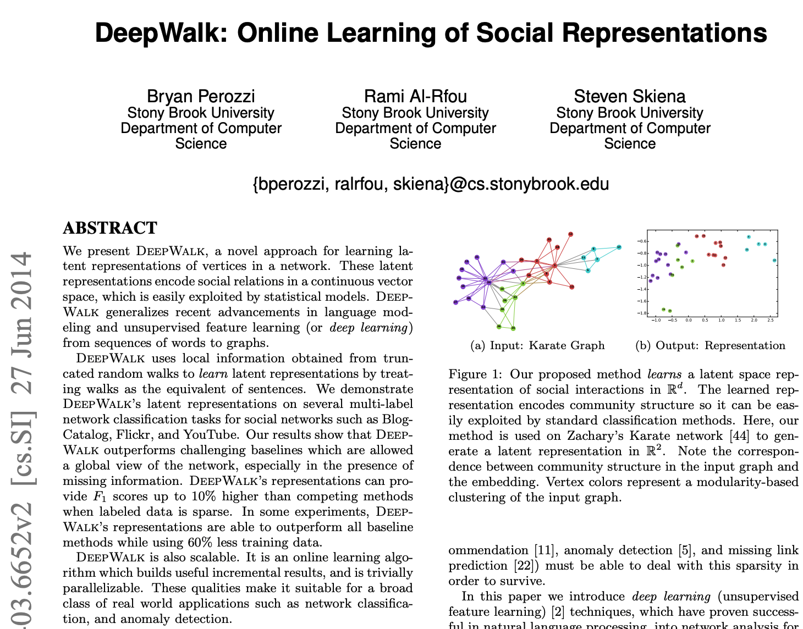
How to represent a graph?
Node Sequences
Random Walk
……
https://arxiv.org/pdf/1403.6652.pdf

Slide 9
Neural Language Model
聊天
Yoshua Bengio
我
聊天
机器人
，
我
可以
聊天
是
F.Sun et al.: Learning Word Representations by Jointly Modeling Syntagmatic and Paradigmatic Relations (slides), http://www.bigdatalab.ac.cn/~lanyanyan/slides/2015/ACL2015-sun.pdf

Slide 10
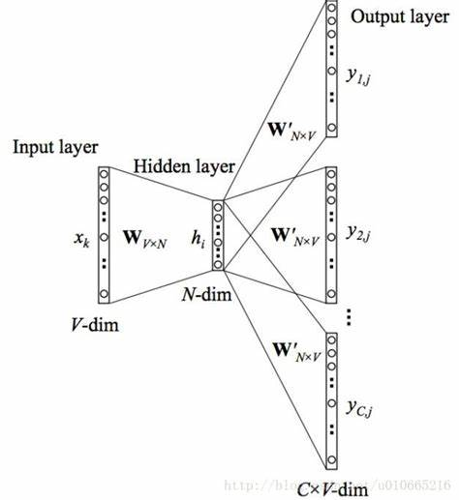
Deep Walk
Node Sequences
Word2Vec
Node Vectors
Random Walk
N₁
……
N₂
N₃
N₄
N₅
N₆
N₇
N₈
N₉
N₁₀
https://arxiv.org/pdf/1403.6652.pdf

Slide 11
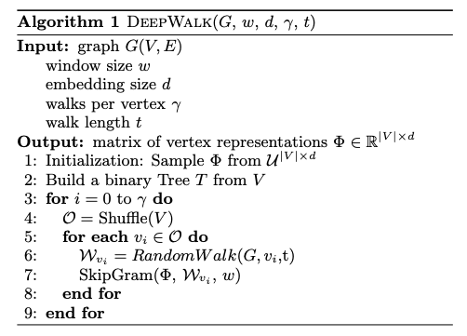
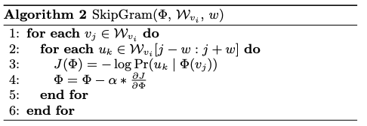
Deep Walk
https://arxiv.org/pdf/1403.6652.pdf

Slide 12
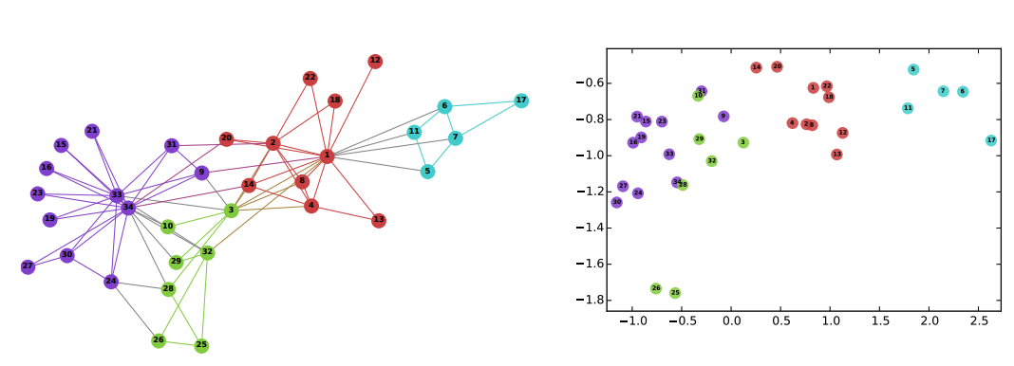
Deep Walk
https://arxiv.org/pdf/1403.6652.pdf

Slide 13
Tasks
Node level：Node classification, Node properties prediction, Community detection, Visualization
Link level：Link classification, Link Prediction, Link property inference
Graph level：Graph classification, Graph generation
……
更多“人工智能 & 复杂系统”的知识，请关注官网：campus.swarma.org

Slide 14
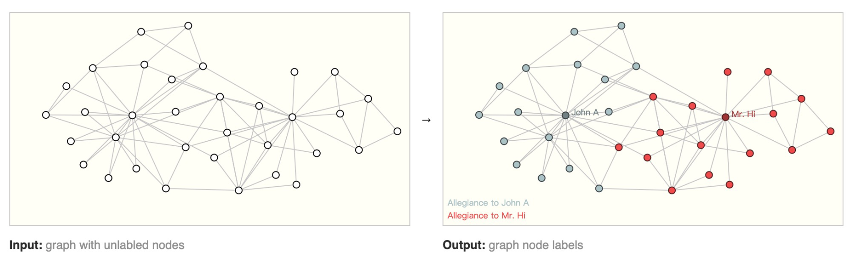
Node Classification/Labelling
有监督、无监督、半监督
更多“人工智能 & 复杂系统”的知识，请关注官网：campus.swarma.org

Slide 15
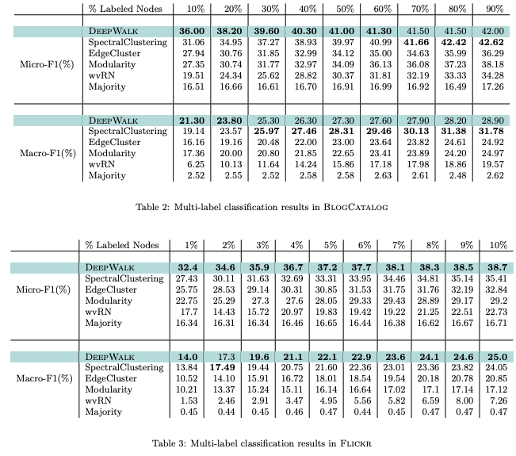
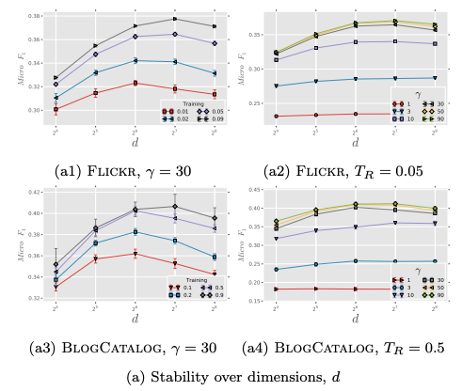
Deep Walk
https://arxiv.org/pdf/1403.6652.pdf

Slide 16
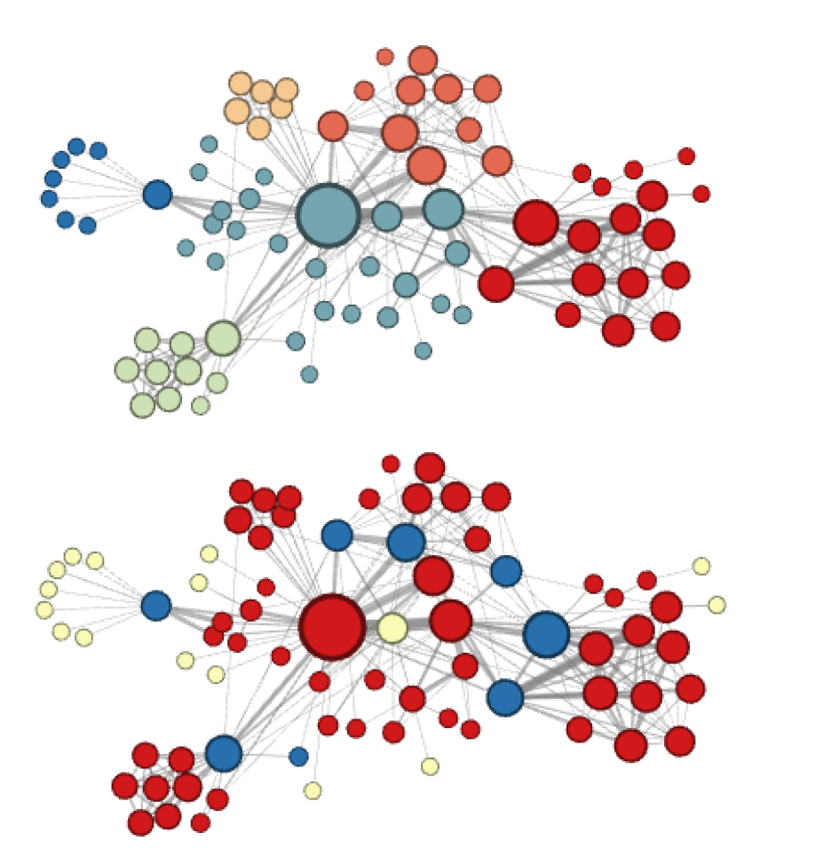
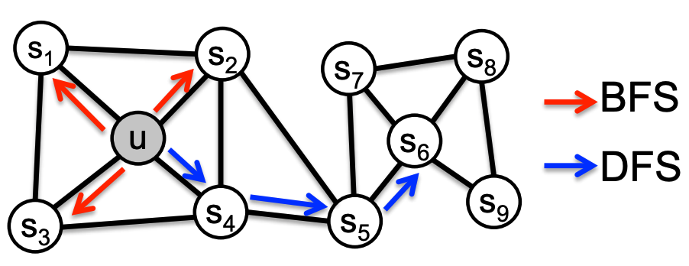
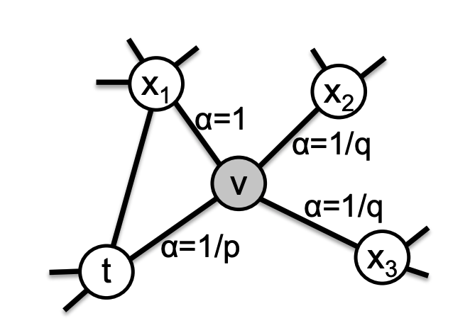
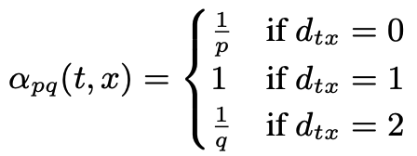
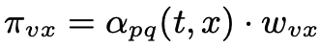
Node2Vec
Homophily, p=1,q=0.5
Structural equivalence, p=1, q=2
Aditya Grover, Jure Leskovec. node2vec: Scalable Feature Learning for Networks. KDD 2016.

Slide 17
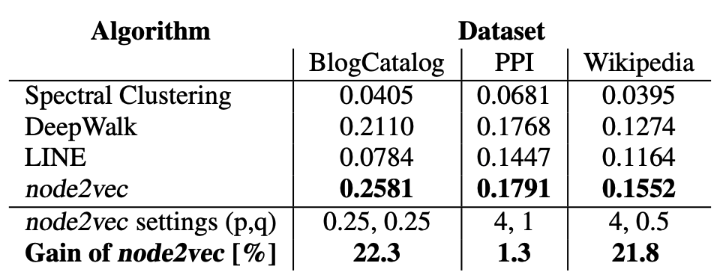
Node Classification/Labelling
39 blogger interests
50 gene types
40 Part-of-Speech tags
Aditya Grover, Jure Leskovec. node2vec: Scalable Feature Learning for Networks. KDD 2016.

Slide 18
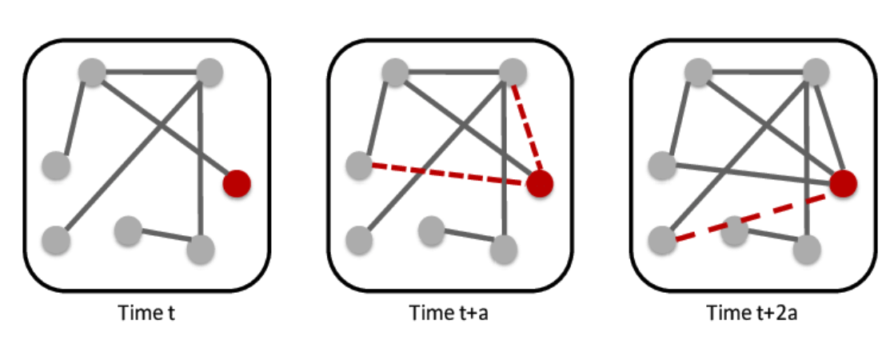
Link Prediction
更多“人工智能 & 复杂系统”的知识，请关注官网：campus.swarma.org

Slide 19
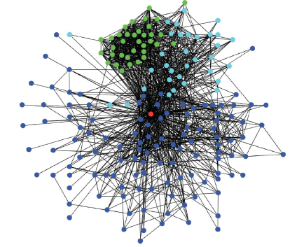
Link Prediction
更多“人工智能 & 复杂系统”的知识，请关注官网：campus.swarma.org

Slide 20
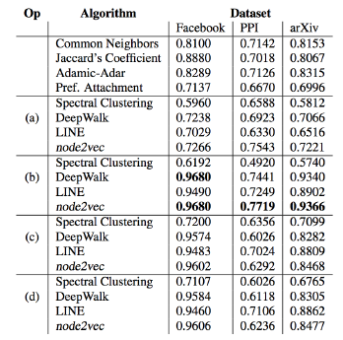
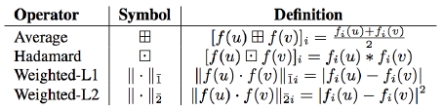
Link Prediction
u,v: nodes, f: embedding function
Area Under Curve (AUC) scores for link prediction. Comparison with popular baselines and embedding based methods bootstapped using binary operators:
(a) Average, (b) Hadamard, (c) Weighted-L1, and (d) Weighted-L2 (See Table 1 for definitions).
更多“人工智能 & 复杂系统”的知识，请关注官网：campus.swarma.org

Slide 21
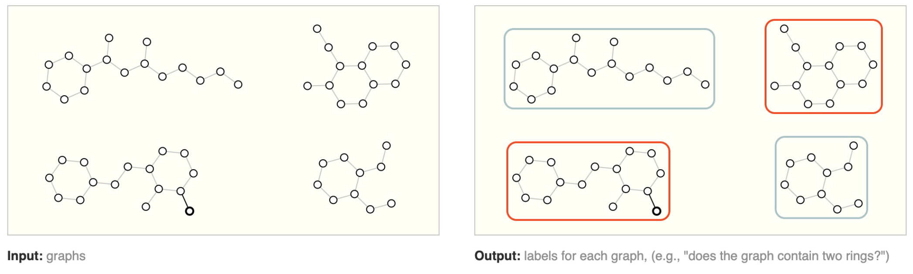
Graph Level Tasks
更多“人工智能 & 复杂系统”的知识，请关注官网：campus.swarma.org

Slide 22
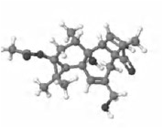
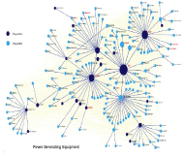
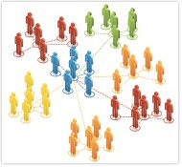
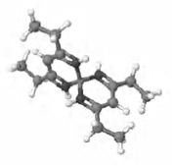
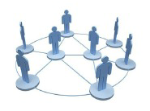
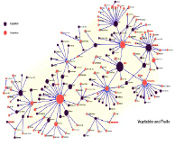
Graph Classification
分子结构网络
社会网络
国际贸易网
Toxic
Long lived
Industrial
non-toxic
Dead
Agricultrual
化学药品分类
网络社区分类
贸易产品分类
更多“人工智能 & 复杂系统”的知识，请关注官网：campus.swarma.org

Slide 23
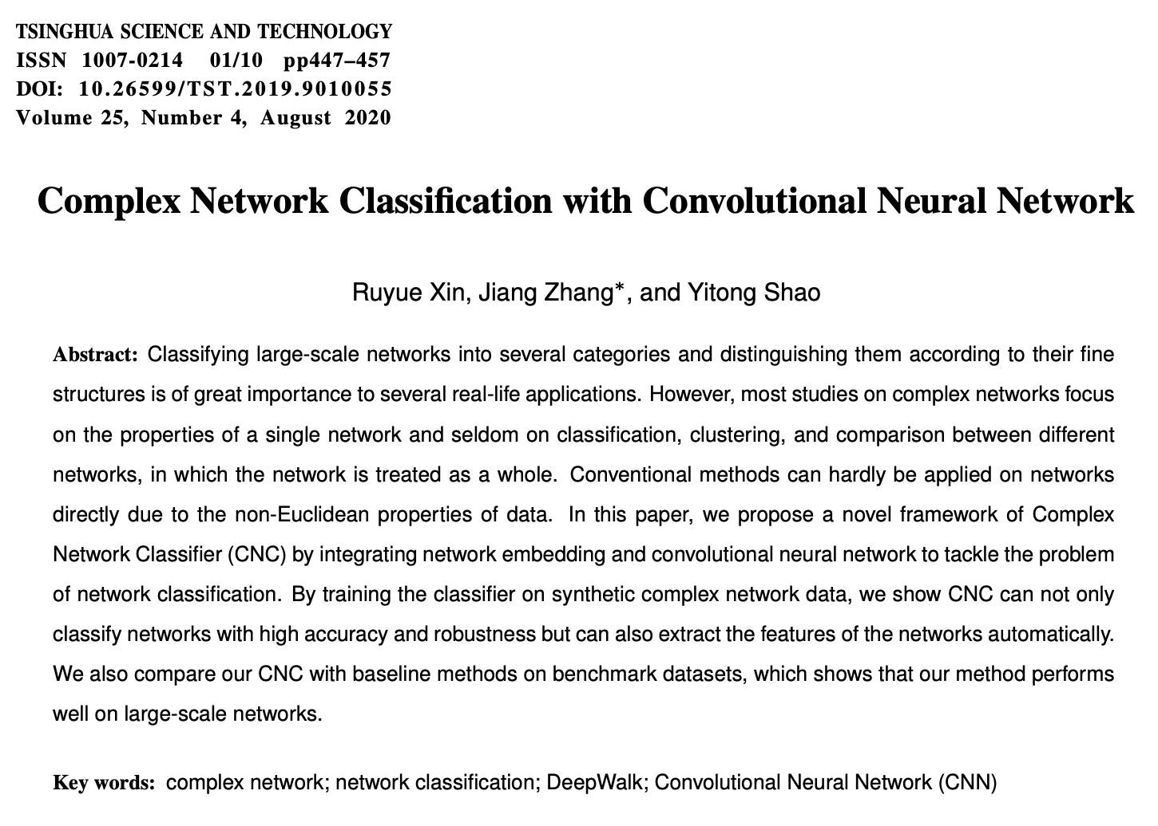
Graph Classification
Ruyue Xin,Jiang Zhang,Yitong Shao. Complex Network Classification with Convolutional Neural Network; Tsinghua Science and Technology, Volume 25, Number 4, 2020

Slide 24
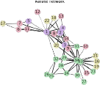
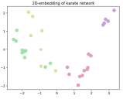
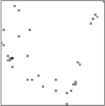
Graph Classification
原始网络
嵌入向量
二维栅格化
Class 1
Class 2
CNN：卷积神经网络
Ruyue Xin,Jiang Zhang,Yitong Shao. Complex Network Classification with Convolutional Neural Network; Tsinghua Science and Technology, Volume 25, Number 4, 2020

Slide 25
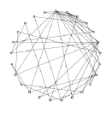
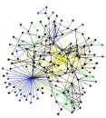
Graph Classification
嵌入向量
二维栅格化
小世界网络
无标度网络
CNN：卷积神经网络
Ruyue Xin,Jiang Zhang,Yitong Shao. Complex Network Classification with Convolutional Neural Network; Tsinghua Science and Technology, Volume 25, Number 4, 2020

Slide 26
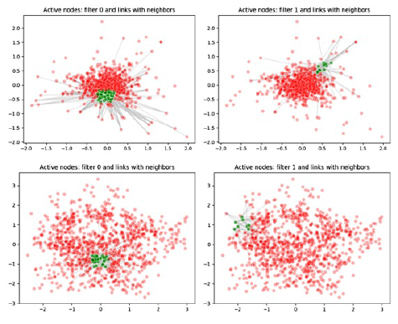
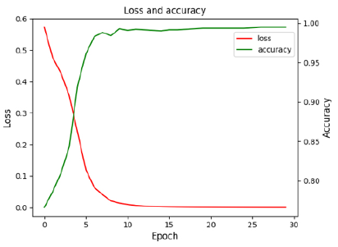
Results
无标度
小世界
Ruyue Xin,Jiang Zhang,Yitong Shao. Complex Network Classification with Convolutional Neural Network; Tsinghua Science and Technology, Volume 25, Number 4, 2020

Slide 27
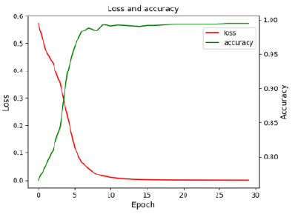

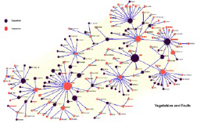
Results
Electronic
Agricultrual
The classifier can distinguish agricultural trade networks and electronic product trade networks with accuracy 99%
Ruyue Xin,Jiang Zhang,Yitong Shao. Complex Network Classification with Convolutional Neural Network; Tsinghua Science and Technology, Volume 25, Number 4, 2020

Slide 28
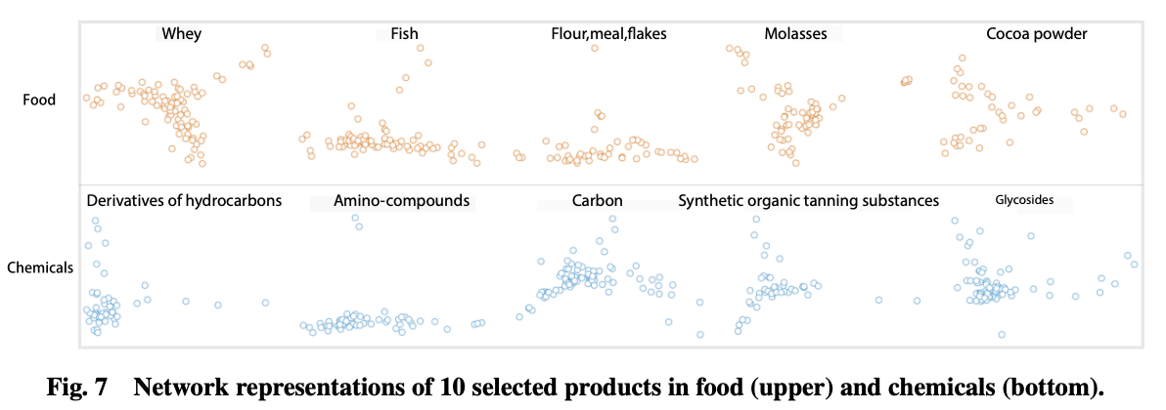
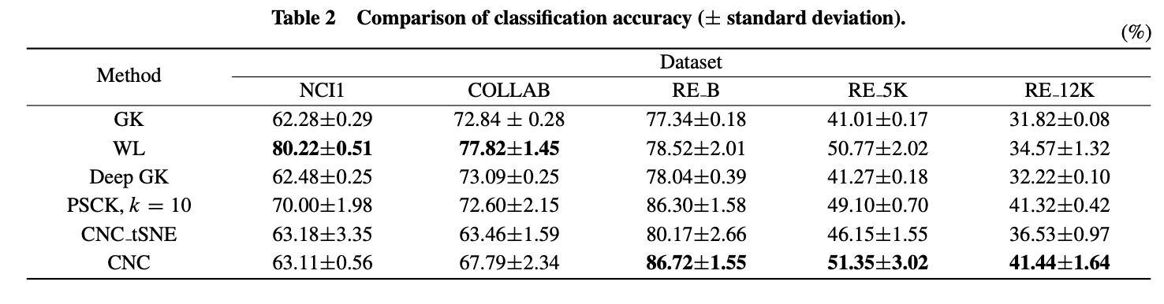
Results
Ruyue Xin,Jiang Zhang,Yitong Shao. Complex Network Classification with Convolutional Neural Network; Tsinghua Science and Technology, Volume 25, Number 4, 2020

Slide 29
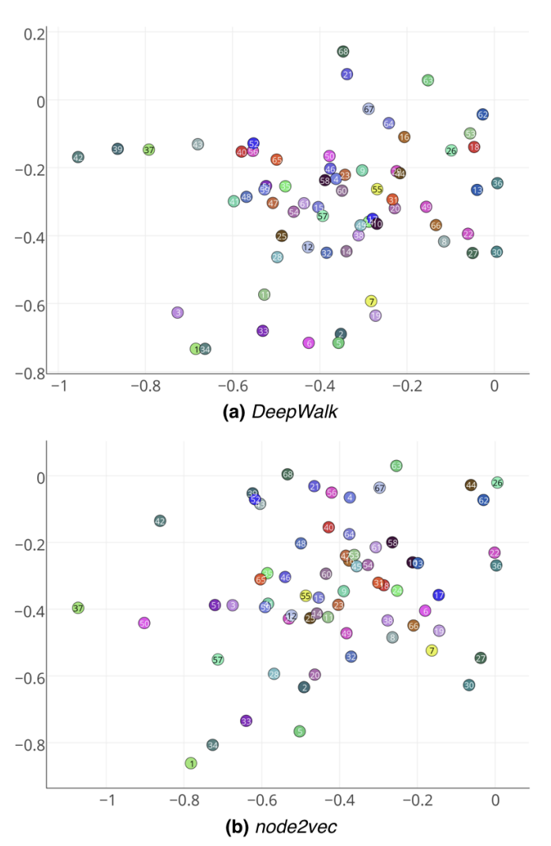
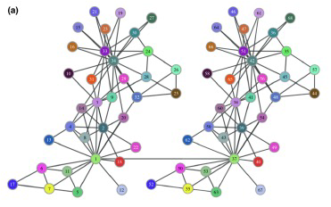
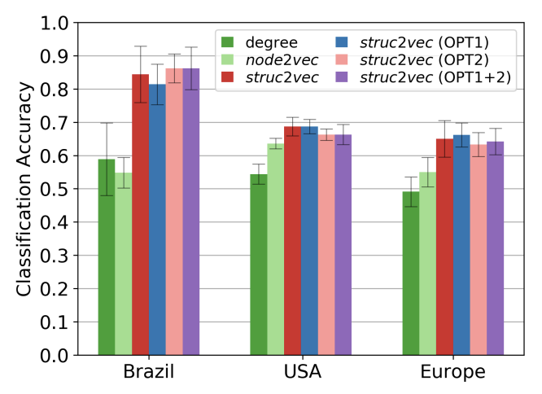
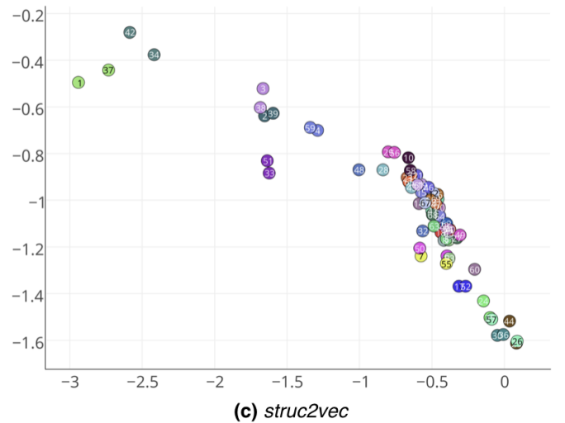
Struct2vec
Leonardo F. R. Ribeiro, Pedro H. P. Saverese, Daniel R. Figueiredo. struc2vec: Learning Node Representations from Structural Identity. KDD 2017

Slide 30
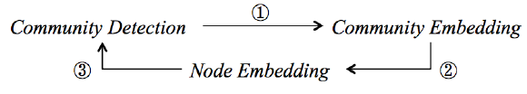
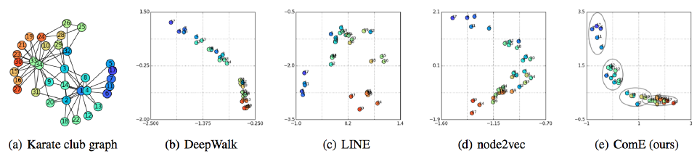
Node – Community Embedding
V.W. Zheng et al.: From Node Embedding To Community Embedding, arXiv:1610.09950v2 , 2017

Slide 31


Knowledge Graph
TransE, TransR
Knoweledge Graph
Embedding
更多“人工智能 & 复杂系统”的知识，请关注官网：campus.swarma.org

Slide 32

Knowledge Graph Embedding
$$d\left(sub,rel,obj\right)=|\left|h+r−t\right||2$$
Wang Z. Knowledge Graph Embedding by Translating on Hyperplanes[J]. AAAI - Association for the Advancement of Artificial Intelligence, 2014.

Slide 33
Multi layer
更多“人工智能 & 复杂系统”的知识，请关注官网：campus.swarma.org

Slide 34
Weak points
需要随机游走，比较费时间
一个图只能得到一组嵌入，不能应付图的变化
很难融入节点、连边属性信息
依赖于词向量技术
更多“人工智能 & 复杂系统”的知识，请关注官网：campus.swarma.org

Slide 35
Outline
Background
Network Embedding
Graph Neural Networks
Graph Convolution
Graph Attention Network
Others
History and Spectral Domain
更多“人工智能 & 复杂系统”的知识，请关注官网：campus.swarma.org

Slide 36

Neural Networks
更多“人工智能 & 复杂系统”的知识，请关注官网：campus.swarma.org

Slide 37



Network Embedding v.s. Graph Neural Networks
更多“人工智能 & 复杂系统”的知识，请关注官网：campus.swarma.org

Slide 38

What is Graph Neural Network？
更多“人工智能 & 复杂系统”的知识，请关注官网：campus.swarma.org

Slide 39

Information
更多“人工智能 & 复杂系统”的知识，请关注官网：campus.swarma.org

Slide 40

Principles of GNN
Node Classification
Input:
Topology (network)
Node attribution
Output:
Classification (Label)
世界是紧密联系的
方案1：将每个节点的特征认为相互独立，训练一个MLP
方案2：每个节点的分类和自己与邻居的特征都有关
节点对称性：每个节点的信息聚合、分类准则都是一样的！
更多“人工智能 & 复杂系统”的知识，请关注官网：campus.swarma.org

Slide 41


Node Symmetry
f
f
更多“人工智能 & 复杂系统”的知识，请关注官网：campus.swarma.org

Slide 42

Information Aggregation
Aggregation:
Use neighbors’ information to update my feature
Recursive:
Aggregation can be recursive
The orders of aggregation is the layer
Self
First order neighbor
Second order neighbor
更多“人工智能 & 复杂系统”的知识，请关注官网：campus.swarma.org

Slide 43

Message Passing
Define Two Functions
Aggregate
Aggregate information of neighborhood to form message m
Update
Update self information according to m and my own feature
更多“人工智能 & 复杂系统”的知识，请关注官网：campus.swarma.org

Slide 44

Message Passing
Requirement for aggregate：
Permutation invariant
$$\left\{1,2,3\right\}≅\{1,3,2\}≅\{2,1,3\}≅\{2,3,1\}≅\{3,1,2\}≅\{3,2,1\}$$
Variant Length
$$\left\{1,2,3\right\},\left\{1, 2\right\},\{6\}$$
Examples:
$$Mean\left(\left\{1,2,3\right\}\right)=2, Sum\left(\left\{1,2,3\right\}\right)=6, Product\left(\left\{1,2,3\right\}\right)=6$$
更多“人工智能 & 复杂系统”的知识，请关注官网：campus.swarma.org

Slide 45

Deep Set
https://arxiv.org/pdf/1703.06114.pdf

Slide 46
Deep Set
Aggregation Function must be set function(permutation invariant):
https://arxiv.org/pdf/1703.06114.pdf

Slide 47

Deep Set
Aggregation Function must be set function(permutation invariant):
https://arxiv.org/pdf/1703.06114.pdf

Slide 48

Graph Convolutional Network(GCN)
https://tkipf.github.io/graph-convolutional-networks/

Slide 49




Graph Convolutional Network(GCN)
$$m_{𝒩(u)}^{k}=Aggragate\left(\left\{h_{u}^{k}|v∈𝒩(u)\right\}\right)=\frac{\sum_{v∈𝒩(u)}{h_{u}^{k}}}{|𝒩(u)|}$$
$$m_{𝒩(u)}^{k}=Aggragate\left(\left\{h_{u}^{k}|v∈𝒩(u)\right\}\right)=\sum_{v∈𝒩(u)}{\frac{h_{u}^{k}}{\sqrt{|𝒩(u)|∙|𝒩(v)|}}}$$
$$h_{u}^{k+1}=Update\left({h_{u}^{k},m}_{𝒩(u)}^{k}\right)=σ(W_{u}^{k}\frac{h_{u}^{k}}{\left|𝒩\left(u\right)\right|}+W_{m}^{k}m_{𝒩(u)}^{k})$$
https://tkipf.github.io/graph-convolutional-networks/

Slide 50





Graph Convolutional Network(GCN)
$$m_{𝒩(u)}^{k}=Aggragate\left(\left\{h_{u}^{k}|v∈𝒩(u)\right\}\right)=\sum_{v∈𝒩(u)}{\frac{h_{u}^{k}}{\sqrt{|𝒩(u)|∙|𝒩(v)|}}}$$
$$h_{u}^{k+1}=Update\left({h_{u}^{k},m}_{𝒩(u)}^{k}\right)=σ(W_{u}^{k}\frac{h_{u}^{k}}{\left|𝒩\left(u\right)\right|}+W_{m}^{k}m_{𝒩(u)}^{k})$$
$$H^{k+1}=σ({\hat{D}}^{−\frac{1}{2}}\hat{A}{\hat{D}}^{−\frac{1}{2}}H^{k}W^{k})$$
$$\hat{A}=A+I$$
$$\hat{D}=diag(Degree\left(\hat{A}\right))$$
https://tkipf.github.io/graph-convolutional-networks/

Slide 51



No Training – just graph convolution
$$Z=Hash\left(\sum_{v∈N\left(u\right)}{h_{v}}\right)$$
https://tkipf.github.io/graph-convolutional-networks/

Slide 52
Semi Supervised
更多“人工智能 & 复杂系统”的知识，请关注官网：campus.swarma.org

Slide 53

Results
更多“人工智能 & 复杂系统”的知识，请关注官网：campus.swarma.org

Slide 54




Graph Attention Network
https://arxiv.org/abs/1710.10903

Slide 55


Graph Attention Network
https://arxiv.org/abs/1710.10903

Slide 56


Comparison
GCN
Deep Set
$$m_{𝒩(u)}^{k}=Aggragate\left(\left\{h_{u}^{k}|v∈𝒩(u)\right\}\right)=\frac{\sum_{v∈𝒩(u}{h_{u}^{k}}}{|𝒩(u)|}$$
$$m_{𝒩(u)}^{k}=Aggragate\left(\left\{h_{u}^{k}|v∈𝒩(u)\right\}\right)=\sum_{v∈𝒩(u)}{\frac{h_{u}^{k}}{\sqrt{|𝒩(u)|∙|𝒩(v)|}}}$$
Graph Attention：
https://arxiv.org/pdf/1703.06114.pdf

Slide 57
Extension: Update

Slide 58

Extended Message Passing

Slide 59

Extended Message Passing

Slide 60
History of GCN
Image Convolution
Graph Signal Processing
Graph Convolution
Spatial GCN
Spectral Graph Convolution
更多“人工智能 & 复杂系统”的知识，请关注官网：campus.swarma.org

Slide 61

Image Convolution
$$\left(f∗g\right)\left(x,y\right)=\sum_{u}{\sum_{v}{f\left(u,v\right)g(x−u,y−v)}}$$
更多“人工智能 & 复杂系统”的知识，请关注官网：campus.swarma.org

Slide 62







Convolution in Frequency Domain
$$\tilde{f}\left(ω\right)=\int_{−∞}^{+∞}{f(x)}e^{−2πiω}dx$$
$$f(x)$$
$$\tilde{g}\left(ω\right)=\int_{−∞}^{+∞}{g(x)}e^{−2πiω}dx$$
$$g(x)$$
$$f∗g\left(x\right)=\int_{−∞}^{+∞}{f\left(x\right)g(x−u)}du$$
$$f∗g\left(x\right)=\frac{1}{2π}\int_{−∞}^{+∞}{\tilde{f∗g}(ω)e^{2πiω}}dω=\frac{1}{2π}\int_{−∞}^{+∞}{\tilde{f}\left(ω\right)∙\tilde{g}\left(ω\right)e^{2πiω}}dω$$
$$\tilde{f∗g}(ω)=\tilde{f}\left(ω\right)∙\tilde{g}\left(ω\right)$$
更多“人工智能 & 复杂系统”的知识，请关注官网：campus.swarma.org

Slide 63
From Image to Graph
更多“人工智能 & 复杂系统”的知识，请关注官网：campus.swarma.org

Slide 64
Graph Signal Processing
How can we convolute this signal?
No convolutional window
No locality
No moving
更多“人工智能 & 复杂系统”的知识，请关注官网：campus.swarma.org

Slide 65
Graph Signal Processing
https://arxiv.org/abs/1211.0053

Slide 66









Laplacian Operator
$$e^{i2πω_{1}x}$$
$$δ(x−x_{1})$$
$$\hat{f}\left(ω\right)=\int_{−∞}^{+∞}{f\left(x\right)e^{i2πωx}dx}$$
$$\left(\begin{matrix}⋮ \\ \hat{f}(ω) \\ ⋮\end{matrix}\right)=\left\langle f,e^{i2πωx}\right\rangle =\left(\begin{matrix}⋱ & ⋮ & \\ ⋮ & e^{i2πωx} & ⋮ \\ & ⋮ & \end{matrix}\right)\left(\begin{matrix}⋮ \\ f(x) \\ ⋮\end{matrix}\right)$$
f(x)
$$e^{i2πω_{2}x}$$
$$−Δe^{i2πωx}＝−\frac{∂^{2}}{∂t^{2}}e^{i2πωx}=\left(2πω\right)2e^{i2πωx}$$
$$δ(x−x_{2})$$
$$δ({x−x}_{3})$$
Therefore, $e^{i2πωx}$ is the eigenvector of Laplacian: L
$$e^{i2πω_{3}x}$$
更多“人工智能 & 复杂系统”的知识，请关注官网：campus.swarma.org

Slide 67

Basics of Graph Theory
$$L=\left(\begin{matrix}−4 & 1 & … \\ 1 & −4 & 1 \\ ⋯ & 1 & ⋯\end{matrix}\right)$$
Graph: W, signal f(i)
更多“人工智能 & 复杂系统”的知识，请关注官网：campus.swarma.org

Slide 68




Basics of Graph Theory
$$D=\left(\begin{matrix}d_{1}=\sum_{j=1}^{n}{w_{1j}} & 0 & \\ 0 & ⋱ & \\ & & d_{n}=\sum_{j=1}^{n}{w_{nj}}\end{matrix}\right)$$
Laplacian:
$$L=D−A$$
Eigenvalues
$$(λ1,λ2,….,λn)$$
Eigenvectors
$$(u1,u2,….,)$$
Graph: W, signal f(i)
https://arxiv.org/abs/1211.0053

Slide 69

Basics of Graph Theory
$$D=\left(\begin{matrix}d_{1}=\sum_{j=1}^{n}{w_{1j}} & 0 & \\ 0 & ⋱ & \\ & & d_{n}=\sum_{j=1}^{n}{w_{nj}}\end{matrix}\right)$$
Laplacian:
$$L=I−D^{−1/2}AD^{−1/2}$$
Eigenvalues
$$(λ1,λ2,….,λn)$$
Eigenvectors
$$(u1,u2,….,)$$
Graph: W, signal f(i)
https://arxiv.org/abs/1211.0053

Slide 70
Graph Signal Processing
For given L of a graph, its eigenvectors are u₁,u₂,…,u_{n}, they are also the bases of Fourier transformation
Fourier transformation of a signal f(i)
Inverse Fourier transformation
Graph: W, signal f(i)
https://arxiv.org/abs/1211.0053

Slide 71
Graph Signal Processing
https://arxiv.org/abs/1211.0053

Slide 72
Defining Graph Convolution
Define convolution on spectral domain
Back on the node domain
It is a linear transformation
$\hat{h}$is a function, U is the matrix made by eigen vectors
https://arxiv.org/abs/1211.0053

Slide 73

Polynomial Kernel
Define convolution on spectral domain
Back on the node domain
It is a linear transformation
$$hθ\left(λ\right)=\sum_{k=0}^{N−1}{θkλk}$$
$\hat{h}$is a function, U is the matrix made by eigen vectors
https://arxiv.org/abs/1211.0053

Slide 74
Graph Convolution on Spectral Domain
https://arxiv.org/abs/1606.09375

Slide 75
Graph Convolution on Spectral Domain
https://arxiv.org/abs/1606.09375

Slide 76

Graph Convolution on Spectral Domain
Chebyshev polynomial
Transformation
https://arxiv.org/abs/1606.09375

Slide 77


Back to Kipf’s GCN
Convolutional kernel:
$θ$ is the parameter, T_{k} is the chebyshev polynomial
Linearized
$$L=IN−D^{1/2}AD^{−1/2}$$
Neural network model:
Filtering:
$$IN+D^{1/2}AD^{−1/2}\sim {\tilde{D}}^{1/2}\tilde{A}{\tilde{D}}^{−1/2}$$
H is the state of the l layer, Ws are the weights
https://arxiv.org/abs/1606.09375

Slide 78
Back to Kipf’s GCN
参考和进一步阅读
1.入门博客：A Gentle Introduction to Graph Neural Networks
2.入门课本：Graph Representation Learning
3.入门公开课：CS224W:Machine Learning with Graphs
4.最新博客：Michael Bronstein
更多“人工智能 & 复杂系统”的知识，请关注官网：campus.swarma.org

Slide 79
Outline
Background
Network Embedding
Graph Neural Networks
Graph Convolution
Graph Attention Network
Others
History and Spectral Domain
更多“人工智能 & 复杂系统”的知识，请关注官网：campus.swarma.org

